Slide 1


2026 Awards Men’s Soccer
Welcome
Coaches Intro (JV and Varsity)
Season Recap (JV and Varsity)
JV Recognition
Varsity Letters / Academic
Team Voted Recognition
Individual Honors
Closing

Slide 2
2026 Awards Men’s Soccer
Before we start thank you!
Rebecca
Melinda
Brienne
Chuck
Lenny

Slide 3
2026 Awards Men’s Soccer
Season Recap Varsity
State Semi-Finalists
Region Runner Up
Southeast District Champions
22 Matches
67 Goals, 41 Assists, GA 20
Goals per match 2.5
19 Different players with goals and assists

Slide 4
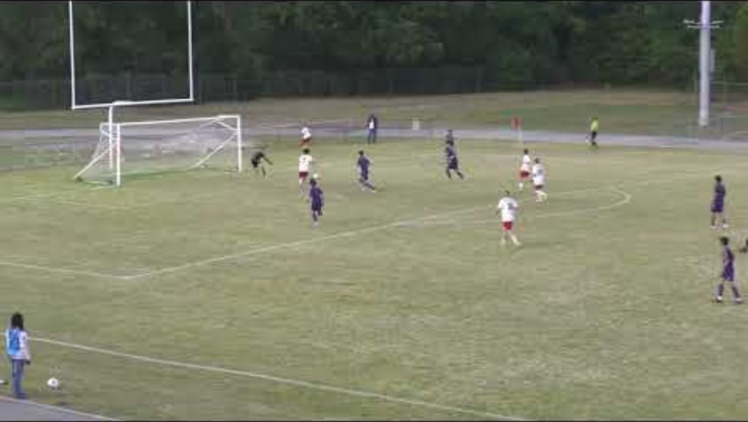

Slide 5
Individual Accomplishments
> 1,500 Minutes
Carter Desler
Preston Ramsey
Kristo Litchmore
Notes:
Players with over 1,500 Minutes Played: Preston Ramsey, Kristo Litchmore, Carter Desler
Best Teammate: Kristo Litchmore
Attacking Player: Landon Eberle
Defender of the Season: Kristo Litchmore
Best Goal of the Season: Jonathan Holston
Most Improved Player: Ethan Koshnaw
Breakout Player of the Year: Carter Desler
Leadership Award: Preston Ramsey

Slide 6
Individual Accomplishments
>1,000 Minutes
Owen Osbourne
Connor Farmer
Matthew Voltz
Jeremy Holston
Neal Challa
Colin Hughes
Landon Eberle
Notes:
Leadership Award: Ben Mercer
All Region:
MVP: Kristo Litchmore

Slide 7
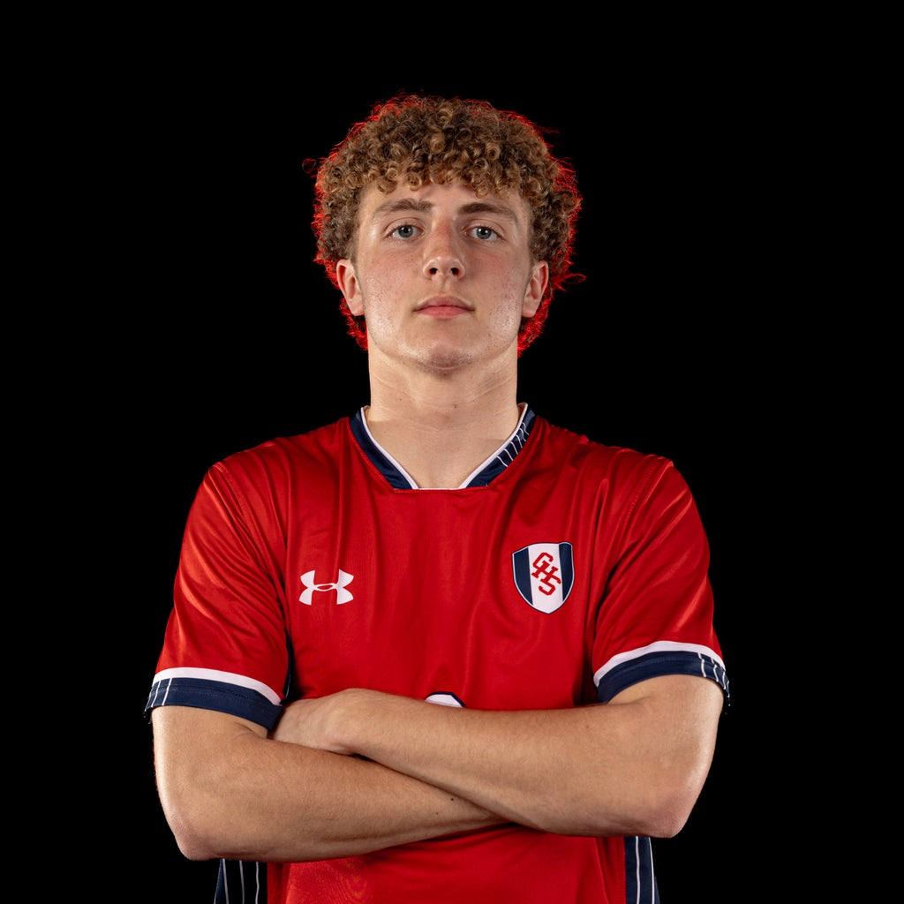
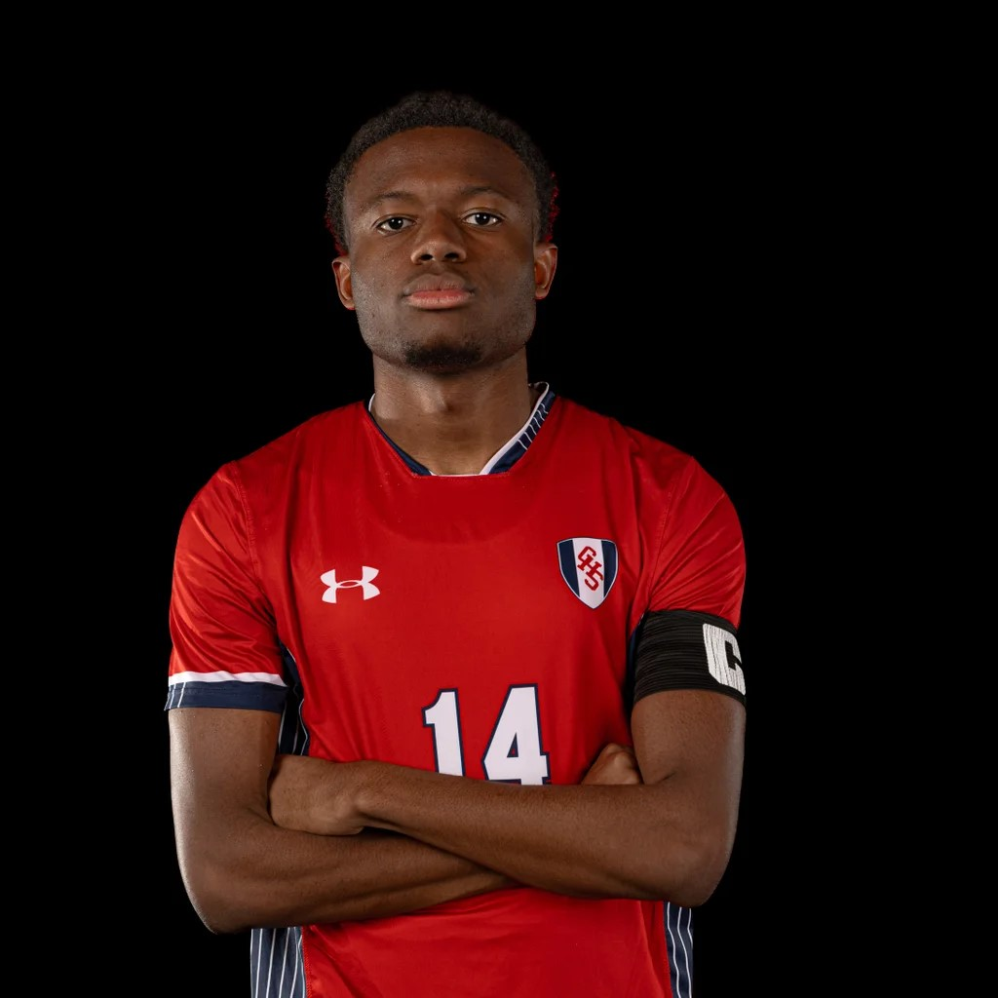
Team Voted Awards
Attacking Player
Best Defender

Slide 8
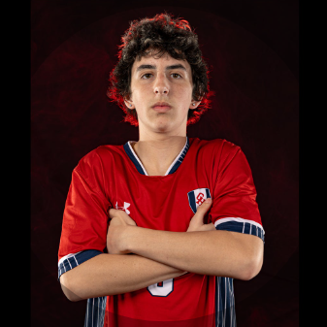
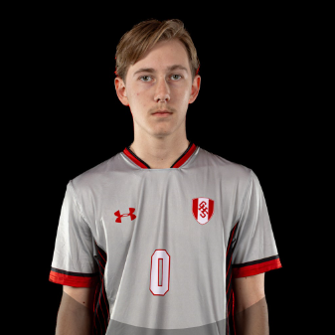
Individual Awards
Season Most Improved Player
Ethan Koshnaw
Breakout Player of the Year
Carter Desler
Notes:
Breakout Player of the Year: Carter Desler
Best Goal of the Season: Jonathan Holston
Leadership Award: Preston Ramsey
All Region:
Second Team: Carter Desler, Colin Hughes, Matthew Voltz
First Team: Kristo Litchmore, Preston Ramsey, Landon Eberle
MVP: Landon Eberle

Slide 9
Team Voted Awards
Best Teammate
Notes:
Players with over 1,000 Minutes Played: Ben Mercer, Preston Ramsey, Kristo Litchmore, Brady Wieck, Luke Riccio
Creative Award: Luke Riccio
Best Teammate: Preston Ramsey
Attacking Player: Preston Ramsey
Defender of the Season: Brady Wieck
Best Goal of the Season: Will Becker (Cox)
Season Most Improved Player: Jeremy Holston
Breakout Player of the Year: Matthew Voltz
Leadership Award: Ben Mercer
All Region:
MVP: Kristo Litchmore

Slide 10
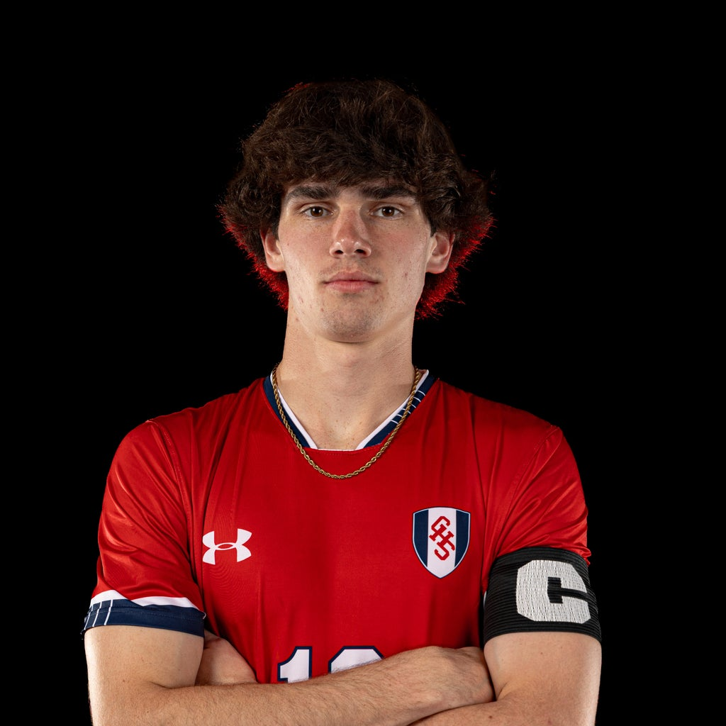
Individual Awards
Leadership Award
Preston Ramsey
Notes:
Players with over 1,000 Minutes Played: Ben Mercer, Preston Ramsey, Kristo Litchmore, Brady Wieck, Luke Riccio
Creative Award: Luke Riccio
Best Teammate: Preston Ramsey
Attacking Player: Preston Ramsey
Defender of the Season: Brady Wieck
Season Most Improved Player: Jeremy Holston
Breakout Player of the Year: Matthew Voltz
Best Goal of the Season: Will Becker (Cox)
Leadership Award: Ben Mercer
All Region:
MVP: Kristo Litchmore

Slide 11
Team Voted Awards
Best Goal of the Season
Landon Eberle (Volley WB)
Jonathan Holston (Top Corner NR)
Jeremy Holston (FC)
Preston Ramsey (Free Kick NR)
Kristo Litchmore (Header NR)
Sam Donahoe (Half Volley)
Kristo Litchmore (Header Deep Creek)
Preston Ramsey (KF top corner)
Luke Killenbeck (Nandua)
Winner

Slide 12
Individual Awards
Class 6A All Region Recognition
6 Players were nominated
Landon Eberle (F)
Preston Ramsey (M)
Matthew Voltz (M)
Kristo Litchmore (D)
Colin Hughes (D)
Carter Desler (GK)
Process
Top 5 players 1st Team
Second 5 players (6-10 voted) 2nd Team
(Forwards, Midfield, Defenders)
Top 2 GKs
POY and COY

Slide 13
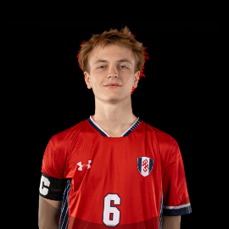
Individual Awards
All Region Recognition
2nd Team All Region
(2026)
Colin Hughes (D)

Slide 14
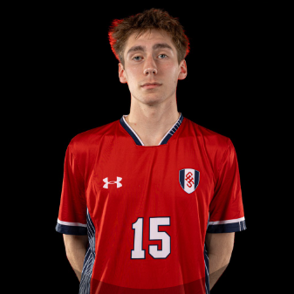
Individual Awards
All Region Recognition
2nd Team All Region
(2025/2026)
Matt Voltz (M)

Slide 15

Individual Awards
All Region Recognition
2nd Team All Region
(2026)
Carter Desler (GK)

Slide 16
Individual Awards
All Region Recognition
1st Team All Region
2-Time 757 All Star Match
Landon Eberle (F)

Slide 17
Individual Awards
All Region Recognition
1st Team All Region (2025/2026)
2-Time 757 All Star Match
Nominated Class 6A POY
Nominated All-Tidewater
Chesapeake Spring Sports
Preston Ramsey (M)

Slide 18
Individual Awards
All Region Recognition
1st Team All Region (2025/2026)
Two-Time 757 All Star Match
All Tidewater 1st Team (2025/2026)
Nominated Chesapeake Spring Sports
Kristo Litchmore (D)

Slide 19
Individual Awards
2026 MVP
Players Nominated by Coaching Staff
Voted by Players
Landon Eberle
Preston Ramsey
Kristo Litchmore
Carter Desler

Slide 20
Individual Awards
2026 MVP
Landon Eberle (F)

Slide 21
Players eligible for All-State
Process: Class 6A,6B,6C,6D
Top 5 from each Region
Forwards (20)
Midfielders (20)
Defenders (20)
GK (4) (50%)
POY (4) (25%)
COY (4) (25%)
Landon Eberle (Forward)
Preston Ramsey (Midfielder)
Kristo Litchmore (Defender)

Slide 22
1st Team ALL STATE
Kristo Litchmore (D)
1st Team ALL STATE

Slide 23
To the Class of 2026
“There’s so much power in believing that everything will work out even when you don’t know how or when. You just believe that it will.”

